Slide 1
Building Renaming Kiosk
Barrett Eidson
March 30, 2023
At UNC Asheville

Slide 2
TABLE OF CONTENTS
01
02
03
WHAT IS THIS PROJECT?
WHY DID THEY GET RENAMED?
IMPACT
04
05
06
LOCATION
DESCRIPTION OF KIOSK
THANK YOU!
UNC Asheville Building Renaming Project Kiosk
TABLE OF CONTENTS

Slide 3
WHAT IS THIS PROJECT?
UNC Asheville Building Renaming Project Kiosk
On Friday, August 28, 2020, the chancellor’s office announced that the Board of Trustees would be renaming various Halls on the UNC Asheville campus.
This project would involve installing a kiosk that provides information regarding the building renaming, which would allow students, staff and faculty, and visitors to learn more about it.

Slide 4
WHICH BUILDINGS GOT RENAMED?
RAY HALL
DYKEMAN HALL
BIRD HALL
DELANEY HALL
UNC Asheville Building Renaming Project Kiosk
Formerly Hoey Hall
Named after Julia Ray
Formerly Vance Hall
Named after Wilma Dykeman
Formerly Ashe Hall
Named after Ella Bird
Formerly Carmichael Hall
Named after Francine Delaney

Slide 5
IMPACT OF THIS PROJECT
UNC Asheville Building Renaming Project Kiosk
During the 2020-2021 academic year the UNC Asheville Building Renaming Task Force was charged with providing recommendations to the Board of Trustees regarding renaming buildings in support of the University’s strategic commitment to diversity, equity, and inclusion.

Slide 6
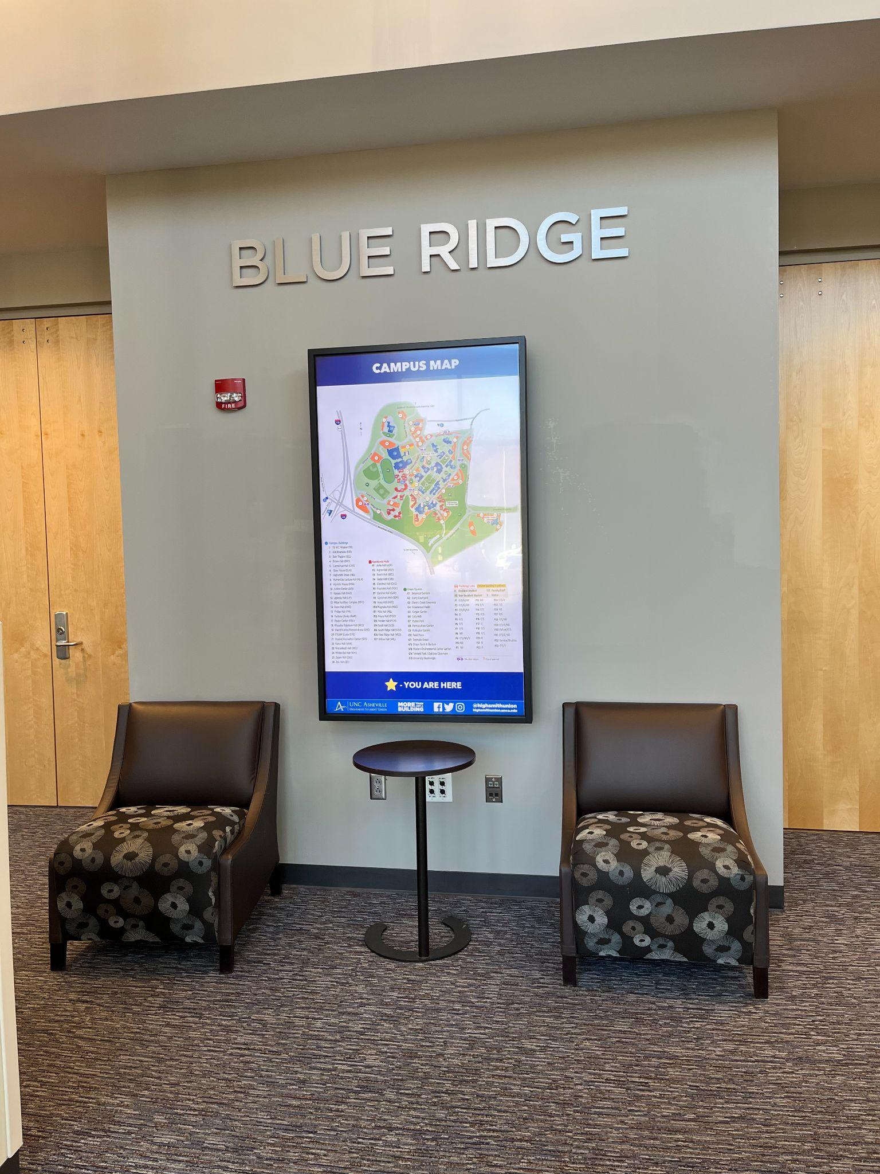
LOCATION OF KIOSK
UNC Asheville Building Renaming Project Kiosk
WEBSITE
The kiosk would be located in Highsmith Student Union near the North entrance. It would be located directly outside the Blue Ridge Room next to the campus map so that users can find the buildings easily. The kiosk would either be on a stand where one of the chairs are.

Slide 7
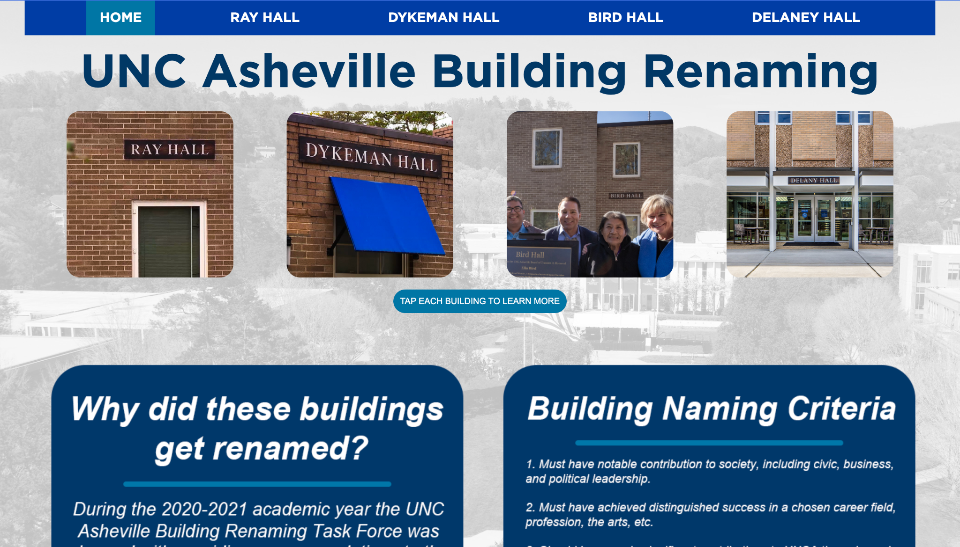
KIOSK HOMEPAGE
UNC Asheville Building Renaming Project Kiosk
WEBSITE
The kiosk’s home screen would consist of 4 tiles, all of which are clickable and take the user to the page of each building. It would also include a section about why the buildings were renamed and the criteria used to rename them.

Slide 8
KIOSK BUILDING PAGES
UNC Asheville Building Renaming Project Kiosk
WEBSITE
Each page would have the name of the building, who it was renamed after, and information about who that person is/their accomplishments/contributions to society.

Slide 9
THANK YOU!

